Slide 1

Computers Principles
10Lecture/ Internet
Civil Engineering Department
College of Engineering / Diyala University/ 2015-2016.
Dr. Qasim Adnan Aljanabi

Slide 2
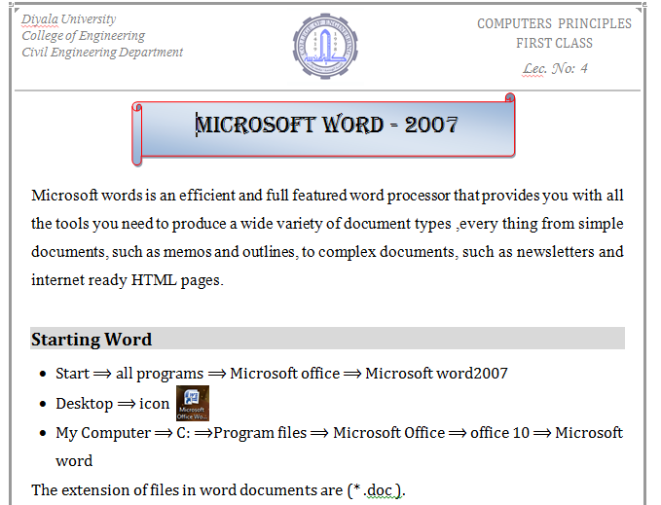

Slide 3
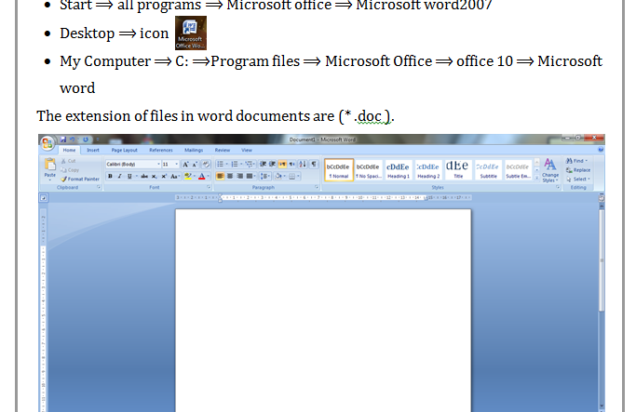

Slide 4
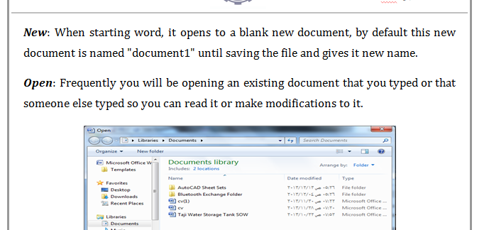

Slide 5
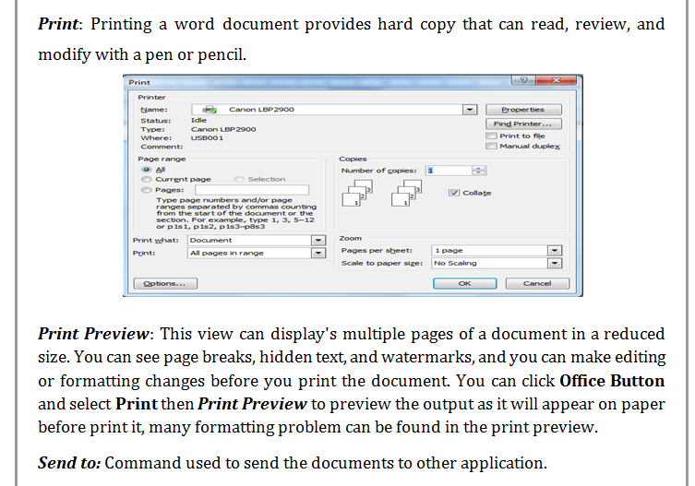

Slide 10
THANK - YOU

